Slide 1
K- Means Clustering

Slide 2
Introduction
Based on the similarities data points are grouped.
Like Cluster 1 and Cluster 2
Algorithms - 5 steps
What Metrics – Euclidian & Manhattan Distance
Elbow method is used to select the K value

Slide 3
Grouping the data by similarities
Cluster 1
x x
x x
x x
x x
x x
x x
x x
x x
x x
x x
x x
Cluster 2
x x
x x
x x

Slide 4
Steps
x x x x x x x
xx x x x x
xx xx xx
Fix the k value (centroids), let us assume k = 2
Initialize the centroids in the plane
Select the points which are closer to the centroids
calculate the mean
Update the centroids and then group
Repeat this process till all the points get classified properly.
Distance is calculated using Euclidian distance
x
x x x x x x x
xx x x x x
xx xx xx
x
x
x x x x x x x
xx x x x x
xx xx xx
x

Slide 5
Example
Points = (2,3,4,7,13,14,17, 20, 25, 30) k = 2
Step 1: m1 = 7
k1= 2,3,4,7
Step 2:
Calculate the mean =4
M1 = 4
2,3,4,7
Step 1: m2 = 17
K2 = 13,14,17,20,25,30
Calculate the mean = 20
M2=20
13,14,17,20,25,30

Slide 6
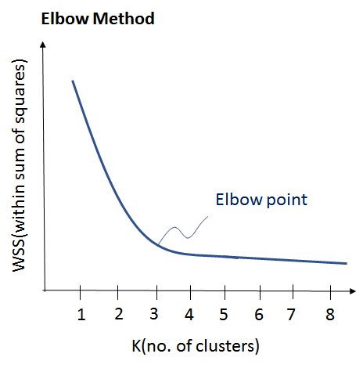
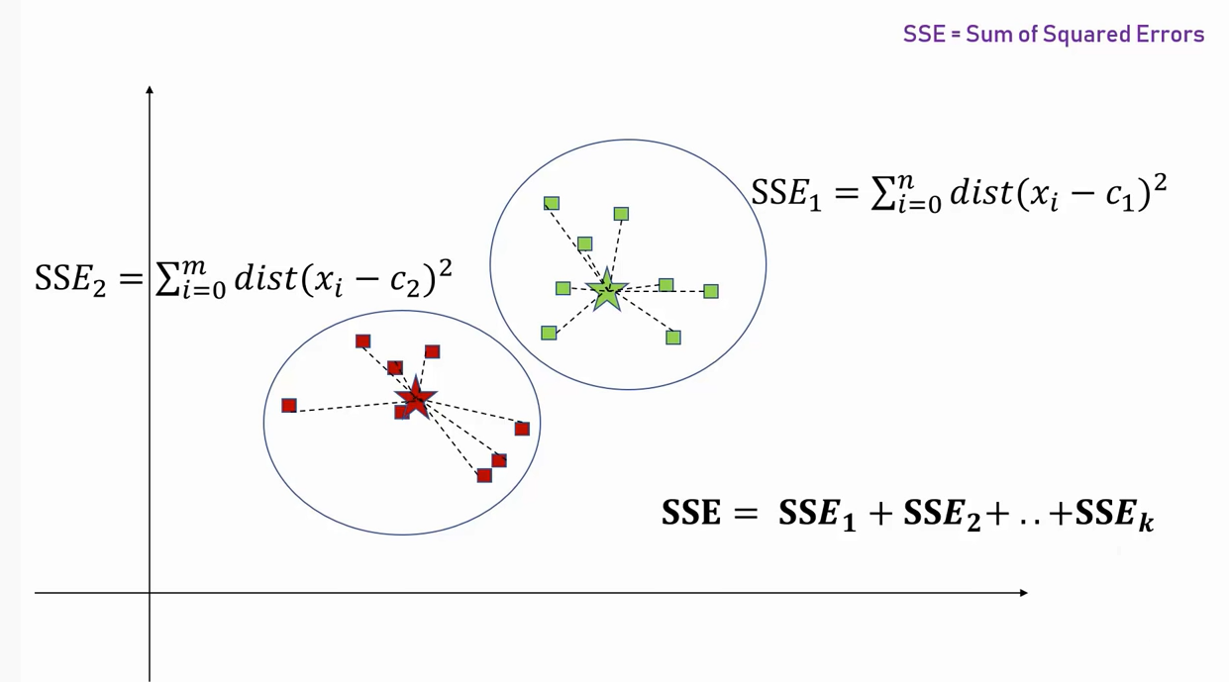
How to determine K value?

Slide 7
AC2 = AB2+BC2
|(x2-x1)| + |(y2-y1)|
X C(x2,y2)
?
X
A (x1,y1)

